Slide 1

Comp 1597 digital media production DMP cakes
Raia, Alissa, Megan, Jasmine

Slide 2
Delegating roles
Different people had different skill sets
Between the roles of designer, and artist are different responsibilities and tasks to do
With creating a website, it was important to find who had more experience with coding and creating a site
Because of the 3D element we wanted to add, we had to also have someone who was comfortable with creating 3D models
Raia – Designer, Megan – Designer, Jasmine – Artist, Alissa - Artist

Slide 3
PRE-PRODUCTION

Slide 4
Foundation
We were trying to think of a product that we all could like, something we would all buy, something we would be willing to test a lot of
We started to talk about desserts and realized we all like cake/cupcakes
Cupcakes that were well known but also ones that we personally liked and enjoyed eating on a regular basis
Not just cupcakes but also cakes
We wanted the cakes to be designable as well, add different toppings and decorations
Including the added feature of 3D models that are coded to change with decision

Slide 5
Changing ideas?
From an app to a website
From a team of 5 to 4
Adapting to the current situation and being flexible enough to continue on and persevere through
Having to still keep our idea complex and stay away from a basic website
Make sure the 3D additions to our site were successful because it made us different and unique

Slide 6
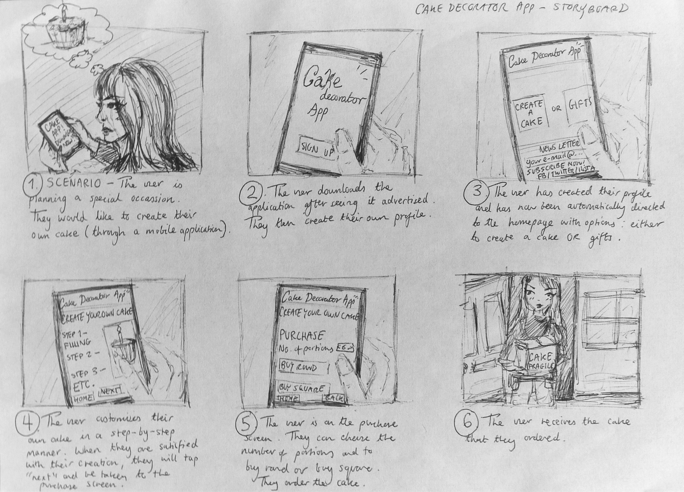
Design concepts LOW-FIDELITY PROTOTYPES
A storyboard was created as a low-fidelity prototype of the proposed artefact during the pre-production phase, where the initial design decisions and conceptualisation was being discussed amongst the group.
The storyboard shows how the user has a “need” outside of the artefact of designing a cake for an upcoming special occasion, and also how the user will interact with the artefact -- where they are able to; sign up, log in, create and customise a cake with a live 3D preview, and finally, purchase and order the cake which they have created.
–

Slide 7
requirements

Slide 8
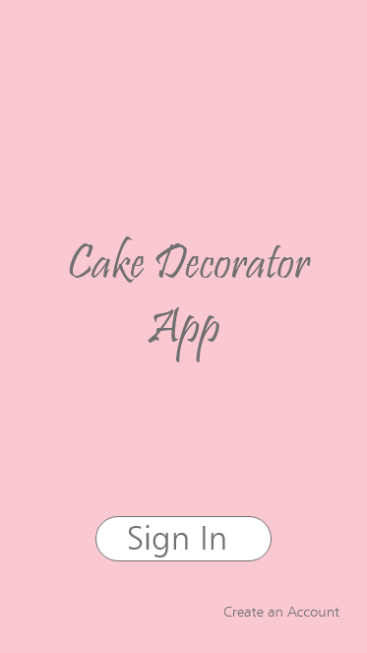
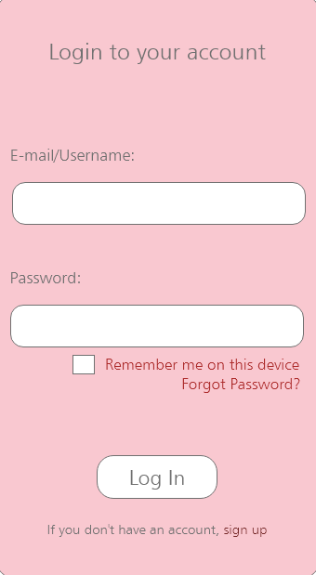
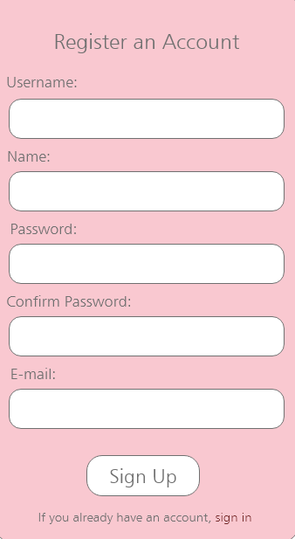
Design concepts HIGH-FIDELITY PROTOTYPES
High-fidelity prototype designs were also created using Invision during the pre-production phase of the artefact -- showing the proposed design decisions for how the mobile application will work and how the user can navigate and interact with the mobile application.
The screens of the mobile application are as follows; the home screen, log in, register an account, main menu, the “create your cake” page, and also the user profile tab which will open when the hamburger menu button is tapped on.

Slide 9
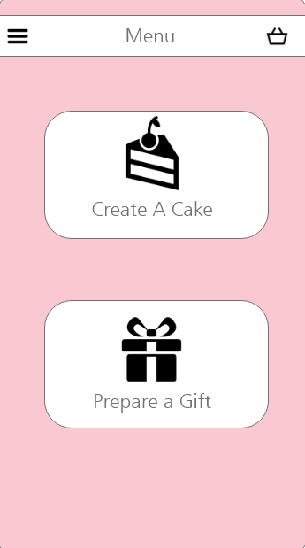
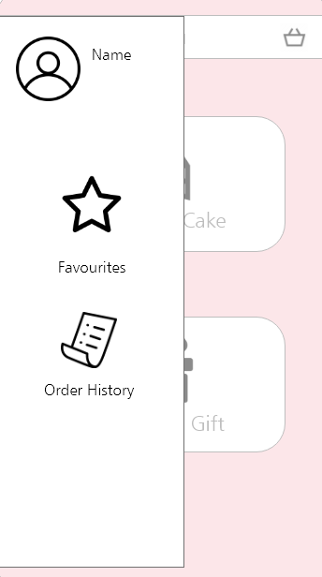
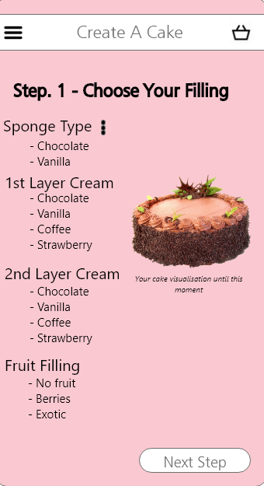
Design concepts HIGH-FIDELITY PROTOTYPES
Furthermore, the high-fidelity prototypes as shown, demonstrate the core concept of the mobile application which was proposed; where the user can customise and order a cake in which they have created through a set list of options in an easy to understand, step-by-step manner, along with a live 3D preview that shows a visualisation of the cake that the user is creating when they select the various design options.

Slide 10
production

Slide 11
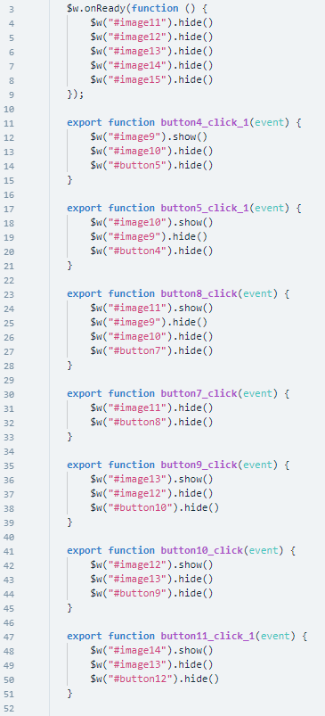
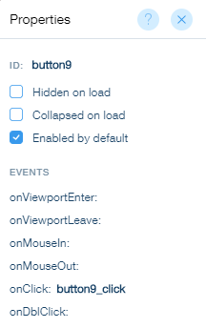
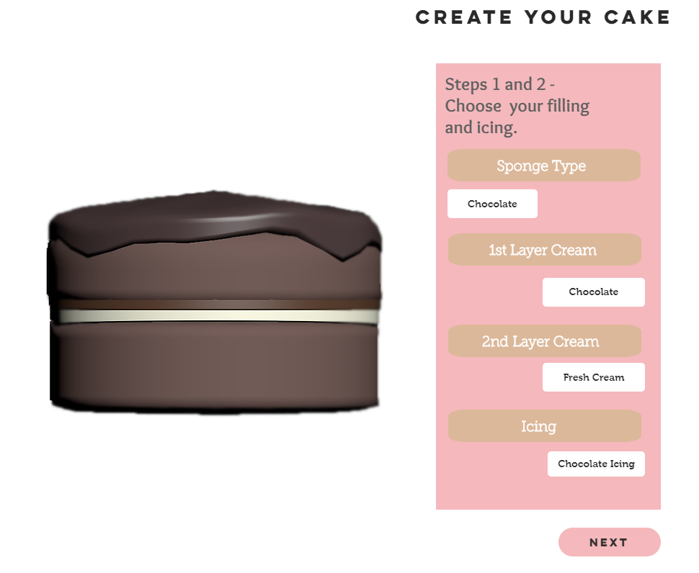
development

Slide 12
development

Slide 13
Testing

Slide 14
Post-production

Slide 15
User evaluation

Slide 16
Future plans?

Slide 17
DEMo
WIKI –
WEBSITE –
ALL SOURCE FILES UPLOADED TO s:\CIS\uploads\COMP1597\CW2\jm1541g

Slide 18
Questions?

